Slide 1

New YORK Airbnb DATASET Presentation 2
Presented By- Pratibha Chougule

Slide 2
Reviving Airbnb NYC Business in the
Post-Covid Period

Slide 3
AGENDA
Objective
Background
Key Findings
Recommendations
Appendix:
Data sources
Data methodology
Data model assumptions

Slide 4
Objective
Improve our strategies to revive the business in the post-COVID period.
Understand customer preferences and user experience trends for Airbnb NYC business.
Provide early recommendations for new acquisitions and improving customer experience.

Slide 5
Background
The COVID-19 pandemic affected Airbnb business due to travel restrictions.
The revenue took the largest hit in NYC in the Q2 of 2020.
Now that the travel restrictions are lifted, the business should be operated to recover the loss.

Slide 6
Key Findings
Customer preferences and ratings of different hosts of Airbnb in were analyzed.
The data was analyzed to derive key insights from the Pre-COVID period.
The insights will be used to take decisions for the NYC Airbnb business for travel in post-COVID period.

Slide 7
Data Preparation and Cleaning
Data is interpreted as column headers (field names).
Data is interpreted as values in the data source.
Data derived from an Excel merged cell is interpreted as value in data source.
Data is ignored and not included as part of the data source.
The data was analyzed using simple statistical analysis of the data.
The visualizations were derived using the Tableau to understand key inferences from the analysis.

Slide 8
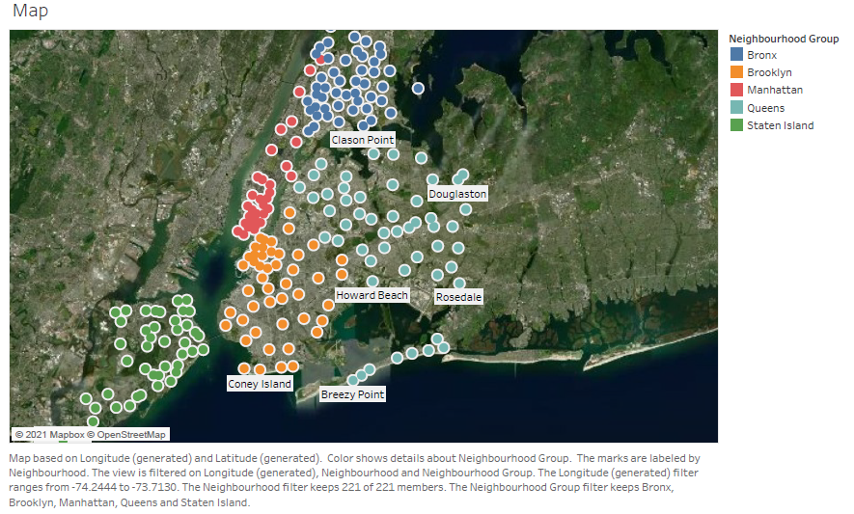
New York Airbnb neighbourhood Group Location

Slide 9
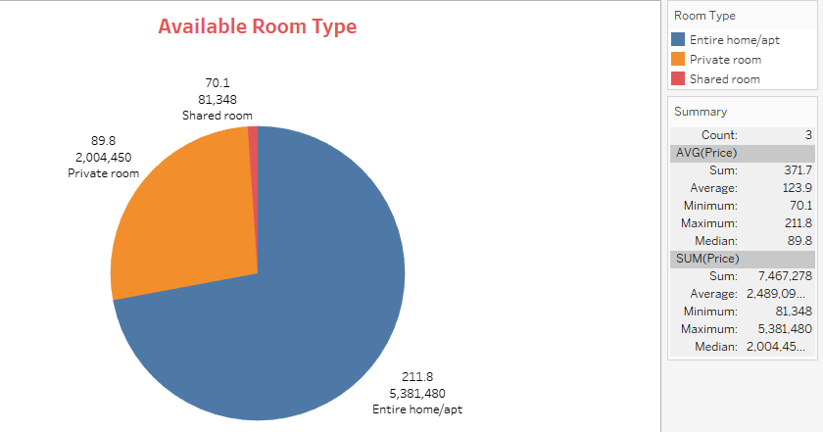
Customer Preferences of the Three Property Types

Slide 10
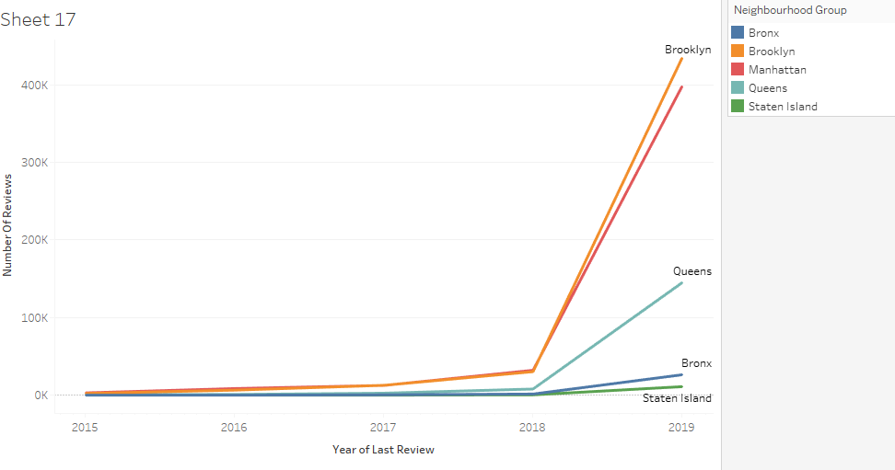
Customer Review For Last 5 Years
Brooklyn is most reviewed area by the customers followed by Manhattan which is most expensive neighbourhood.

Slide 11
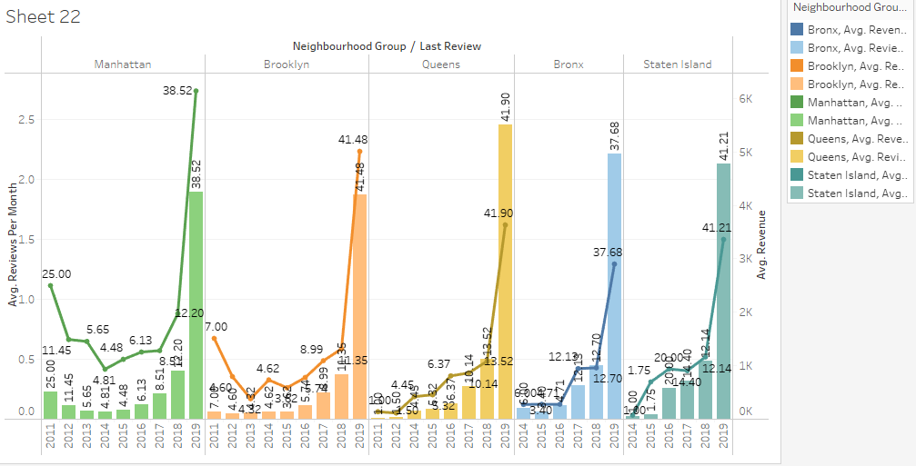
Preferences Details of Customers for area in Airbnb

Slide 12
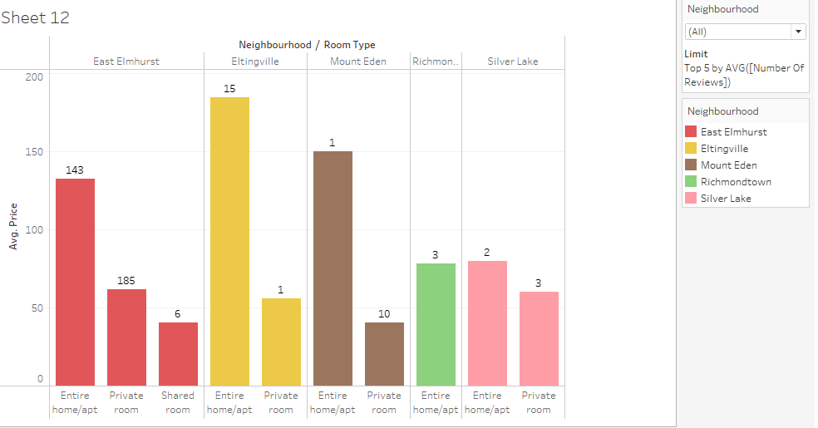
Top 5 neighbourhood Properties Preferred by Customers

Slide 13
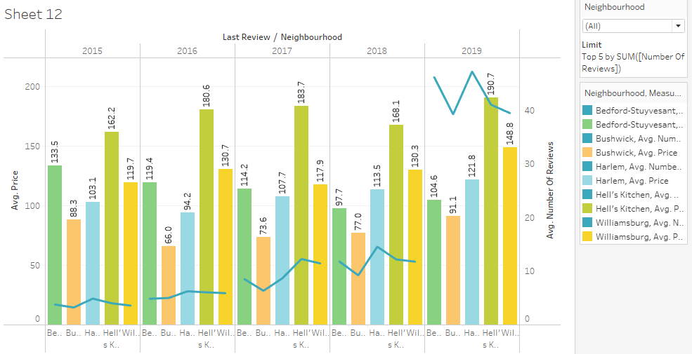
Recent 5 Year Review of Customers against cost

Slide 14
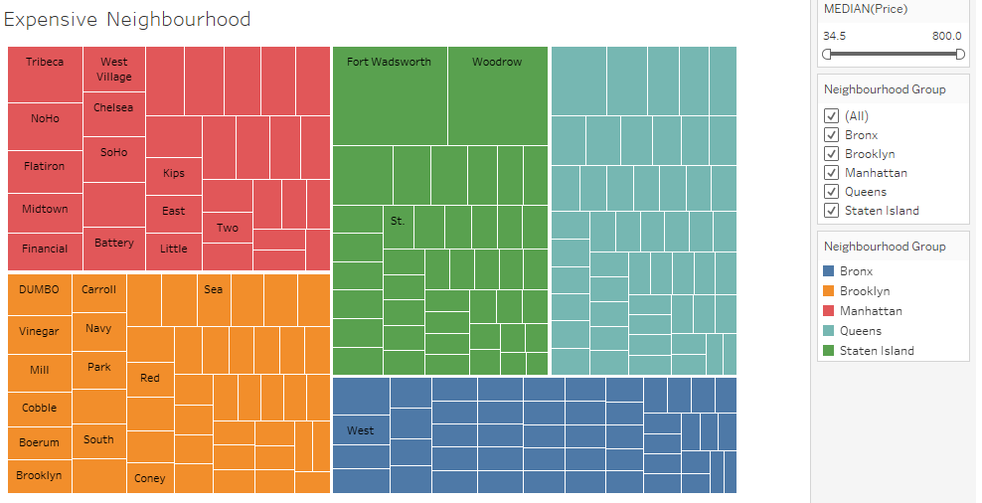
Expensive Area In Airbnb
Manhattan is the most expensive Area followed by Brooklyn.

Slide 15
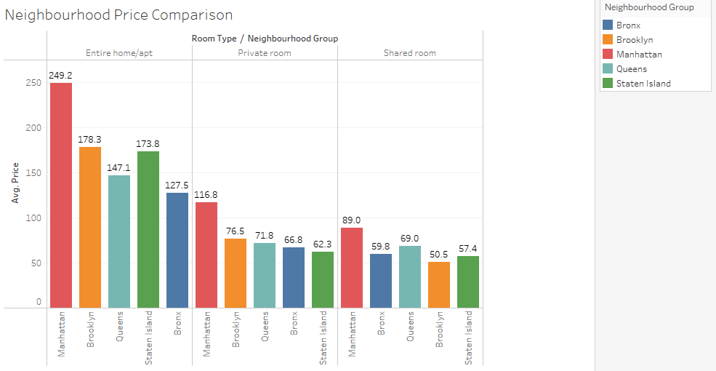
Price Comparison Between Neighbourhood
Prices are different for rooms available in neighbourhood.
Manhattan is quite expensive for all kind of properties.
For home/Apt Bronx is cheaper and for private room and shared room Staten Island and Brooklyn is cheaper respectively.

Slide 16
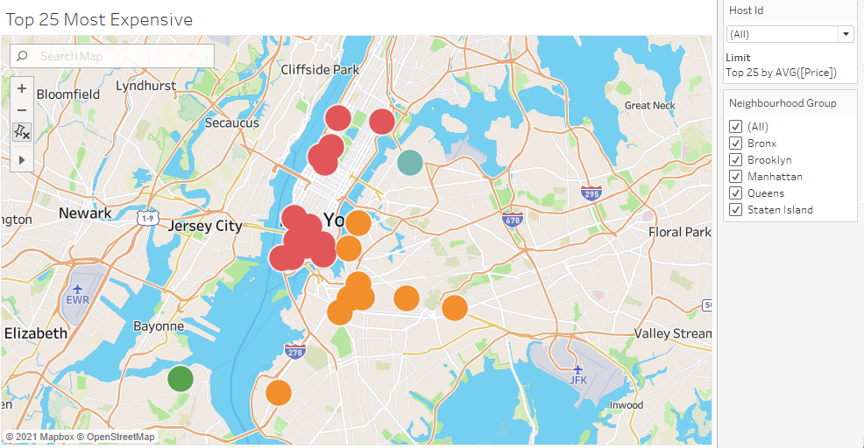
Top 25 Most Expensive Hosts With Location

Slide 17
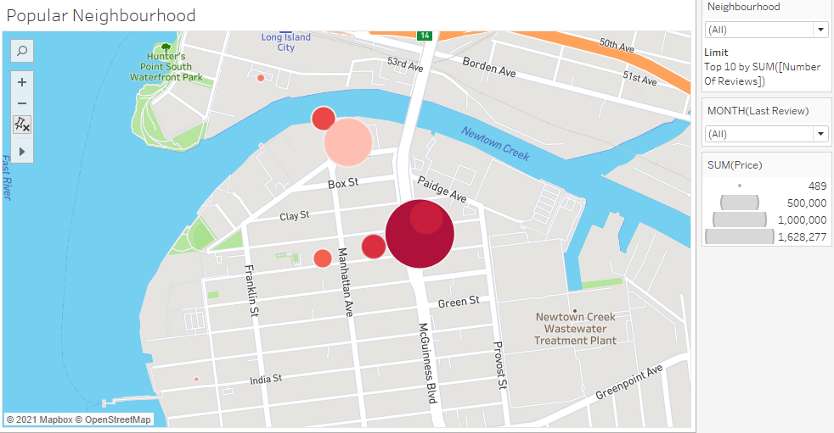
Popular Neighbourhood

Slide 18
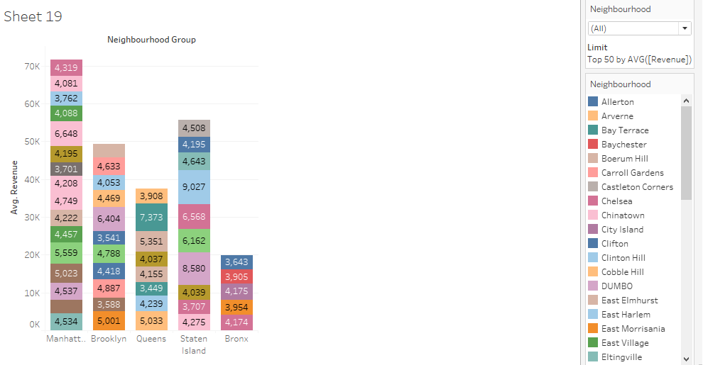
Top 50 Revenue Generated Neighborhoods

Slide 19
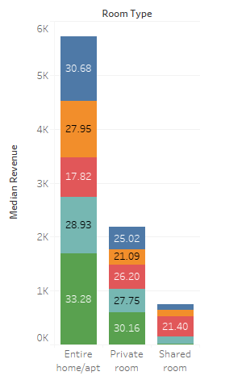
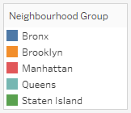
Avg. Customer Review with revenue for Property
Staten Island has Low Revenue but it is more preferred by Customers for Entire home/Apt and Private Room.
Shared Rooms are preferred by Customers in Manhattan. It may be Because of Job preferences.

Slide 20
APPENDIX - DATA METHODOLOGY
We conducted a thorough analysis of the Airbnb data.
The process included:
Cleaning the data set for missing values and outliers
Using tableau to identify customer preferences based on
Area preferences
Price
Listing Preference

Slide 21
APPENDIX - DATA ASSUMPTIONS
We assumed the data prior to the COVID – 19 period was achieving the desired revenue.
We assumed the company does not want to expand yet to new territories in NYC.
The company’s strategies are decided considering the travel will increased in the post COVID period.

